Slide 1


Presenting Cinema Coders

Slide 2

About Our Project
Our HTML project will feature the top 10 actors and directors during a period of time . It will feature a full Movie Lens dataset obtained from GroupLens website.

Slide 3

Visualization of Data Componets Used
Incorporate javascript timeline library
API
Build_database.py
SQL
App.py(flask)
Index.html
Main.js

Slide 4


Retrieval and Use of Datasets and Api’s
Initialize variables used in making API calls to TMDB.
Make calls to TMDB's APIs to retrieve and store data into lists.
Request: 2013-01-01 to 2023-01-14 (Pages 1-500)
At the end of the query, verify the Total Number of Movies added.
Store lists of movies, directors, and actors into DataFrames.
Save JSON files of movies, directors, and actors.
Connect to the local Postgres database and store movies, directors, and actors into the respective tables. Tables within the local Postgres database should already be created before attempting.
The app is being run through app.py at the end.

Slide 5

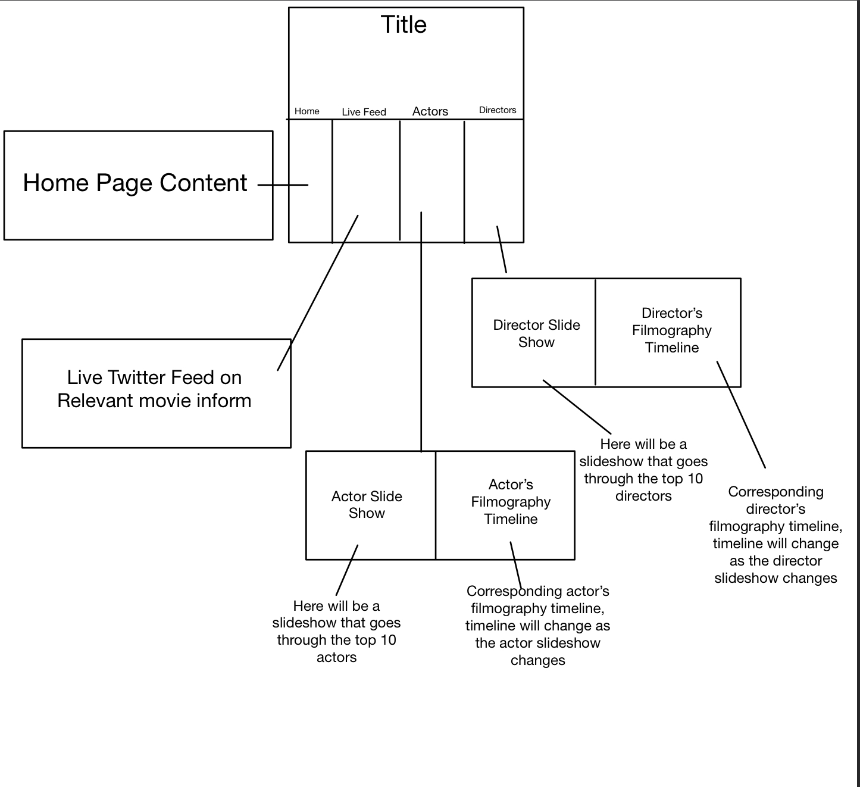

Our HTML Website

